Slide 1
Vocabulary!
Take out a piece of paper and a pen.
Read the sentences and think of the meaning of the red words, phrases or the picture.
Write on your paper 1 or 2 words that similar or close in the meaning of the red words or phrases.
Finally, share your guesses of the meanings of the words.
You will be able to know the definitions of each of the Red words or phrases after all students take turn sharing answers.

Slide 2
Silver lining
If there's a silver lining to losing my job, it's that I'll now be able to go to school full-time and finish my degree earlier.
After the student realized she was failing four courses at her high school, there was a silver lining when she became aware that each course was offering extra credit.
“Even the worst situations have a silver lining,” said the optimistic woman, “because nothing can be totally terrible.”
“Every cloud has a silver lining"
Definition: Said to emphasize that every difficult or unpleasant situation has some advantage.

Slide 3
Predominantly (adv)
Since teens are easily distracted, automobile crashes are the predominant cause of death among that particular age group.
Immigration is the predominant issue on which most politicians are focusing.
Religion is the predominant theme of the play.
Definition: mostly or mainly

Slide 4
Phenomenon
The movie eventually became a cultural phenomenon.
The four-year-old boy was considered a phenomenon because he could play the piano like a master pianist.
Each time a new social media site is revealed it becomes a phenomenon for a while and then slowly fades into obscurity.
Definition: something (such as an interesting fact or event) that can be observed and studied and that typically is unusual or difficult to understand or explain fully

Slide 5
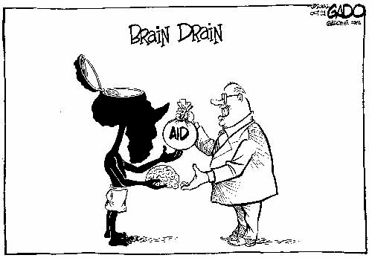
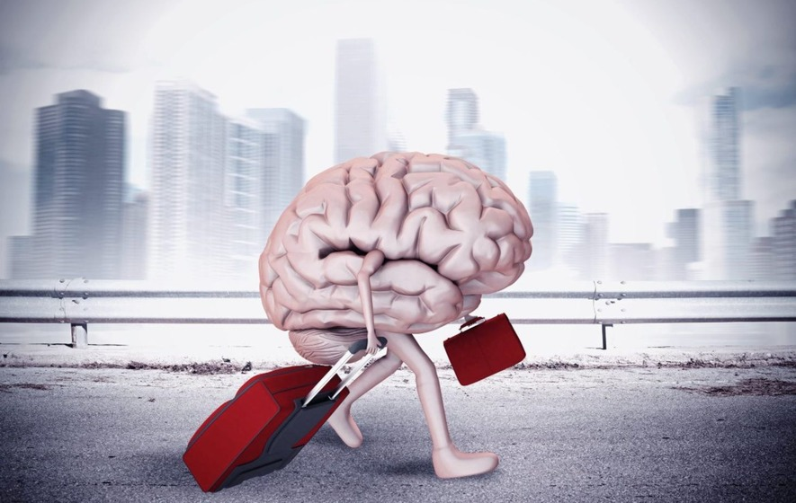
Brain Drain
What can you understand of these pictures?
Definition: a situation in which many educated or professional people leave a particular place or profession and move to another one that gives them better pay or living conditions.

